Slide 1

APEX INSTITUTE OF TECHNOLOGY
DEPARTMENT OF COMPUTER SCIENCE & ENGINEERING
Machine Learning (21CSH-286)
Faculty: Prof. (Dr.) Madan Lal Saini(E13485)
Lecture - 7
Data Transformation, Normalization,
Dimensionality reduction
DISCOVER . LEARN . EMPOWER

Slide 2
DBMS: Course Objectives
COURSE OBJECTIVES
The Course aims to:
Understand and apply various data handling and visualization techniques.
Understand about some basic learning algorithms and techniques and their applications, as well as general questions related to analysing and handling large data sets.
To develop skills of supervised and unsupervised learning techniques and implementation of these to solve real life problems.
To develop basic knowledge on the machine techniques to build an intellectual machine for making decisions behalf of humans.
To develop skills for selecting suitable model parameters and apply them for designing optimized machine learning applications.

Slide 3
COURSE OUTCOMES
On completion of this course, the students shall be able to:-
CO1 | Understand machine learning techniques and computing environment that are suitable for the applications under consideration.
CO2 | Understand data pre-processing techniques and apply these for data cleaning.
CO3 | Identify and implement simple learning strategies using data science and statistics principles.

Slide 4
Unit-1 Syllabus
Unit-1 | Introduction to Machine Learning
Introduction to Machine Learning | Definition and Classification of Machine Learning algorithms, Supervised Learning, Unsupervised Learning, Reinforcement Learning, Semi-Supervised Learning, Applications of Machine Learning.
Data Pre-Processing and Feature Extraction | Handling Missing data, Encoding Categorical data, Feature Scaling, Handling Time Series data; Feature Selection techniques, Data Transformation, Normalization, Dimensionality reduction
Data Visualization | Data Frame Basics, Different types of plots, Plotting fundamentals using Matplotlib, Plotting fundamentals using Seaborn.

Slide 5
SUGGESTIVE READINGS
TEXT BOOKS:
T1: Tom.M.Mitchell, “Machine Learning, McGraw Hill International Edition”.
T2: Ethern Alpaydin,” Introduction to Machine Learning. Eastern Economy Edition, Prentice Hall of India, 2005”.
T3: Andreas C. Miller, Sarah Guido, Introduction to Machine Learning with Python, O’REILLY (2001).
REFERENCE BOOKS:
R1 Sebastian Raschka, Vahid Mirjalili, Python Machine Learning, (2014)
R2 Richard O. Duda, Peter E. Hart, David G. Stork, “Pattern Classification, Wiley, 2nd Edition”.
R3 Christopher Bishop, “Pattern Recognition and Machine Learning, illustrated Edition, Springer, 2006”.

Slide 6
Data Transformation
Data Transformation
Data transformation is one of the fundamental steps in the part of data processing. When I first learnt the technique of feature scaling, the terms scale, standardise, and normalise are often being used. However, it was pretty hard to find information about which of them I should use and also when to use.
What Does Feature Scaling Mean?
In practice, we often encounter different types of variables in the same dataset. A significant issue is that the range of the variables may differ a lot. Using the original scale may put more weights on the variables with a large range. In order to deal with this problem, we need to apply the technique of features rescaling to independent variables or features of data in the step of data pre-processing. The terms normalisation and standardisation are sometimes used interchangeably, but they usually refer to different things.

Slide 7
Data Transformation
A dataset that contains an independent variable (Purchased) and 3 dependent variables (Country, Age, and Salary). We can easily notice that the variables are not on the same scale because the range of Age is from 27 to 50, while the range of Salary going from 48 K to 83 K. The range of Salary is much wider than the range of Age. This will cause some issues in our models since a lot of machine learning models such as k-means clustering and nearest neighbour classification are based on the Euclidean Distance.
Focusing on age and salary
When we calculate the equation of Euclidean distance, the number of (x2-x1)² is much bigger than the number of (y2-y1)² which means the Euclidean distance will be dominated by the salary if we do not apply feature scaling. The difference in Age contributes less to the overall difference. Therefore, we should use Feature Scaling to bring all values to the same magnitudes and, thus, solve this issue. To do this, there are primarily two methods called Standardisation and Normalisation.

Slide 8
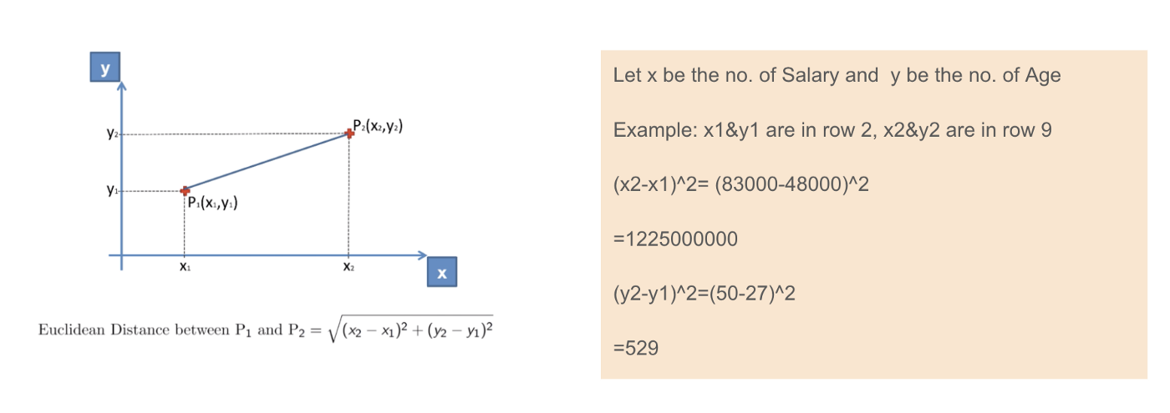
Data Transformation

Slide 9

Normalization
Max-Min Normalization
Another common approach is the so-called Max-Min Normalization (Min-Max scaling). This technique is to re-scales features with a distribution value between 0 and 1. For every feature, the minimum value of that feature gets transformed into 0, and the maximum value gets transformed into 1. The general equation is shown below:
Standardisation vs Max-Min Normalization
In contrast to standardisation, we will obtain smaller standard deviations through the process of Max-Min Normalisation. Let me illustrate more in this area using the above dataset.

Slide 10
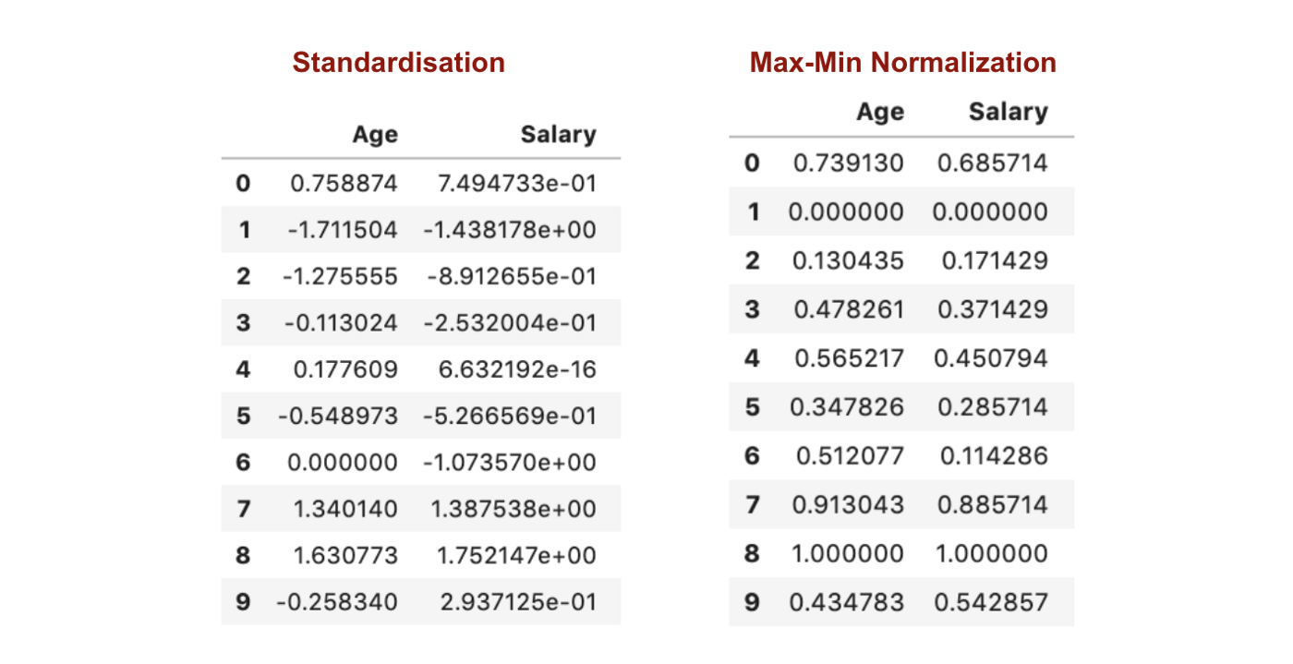
Normalization

Slide 11
Normalization
From the above graphs, we can clearly notice that applying Max-Min Nomaralisation in our dataset has generated smaller standard deviations (Salary and Age) than using Standardisation method. It implies the data are more concentrated around the mean if we scale data using Max-Min Nomaralisation.
As a result, if you have outliers in your feature (column), normalizing your data will scale most of the data to a small interval, which means all features will have the same scale but does not handle outliers well. Standardisation is more robust to outliers, and in many cases, it is preferable over Max-Min Normalisation.

Slide 12
Dimensionality Reduction
What is Dimensionality Reduction?
In machine learning classification problems, there are often too many factors on the basis of which the final classification is done. These factors are basically variables called features. The higher the number of features, the harder it gets to visualize the training set and then work on it. Sometimes, most of these features are correlated, and hence redundant. This is where dimensionality reduction algorithms come into play. Dimensionality reduction is the process of reducing the number of random variables under consideration, by obtaining a set of principal variables. It can be divided into feature selection and feature extraction.

Slide 13
Dimensionality Reduction
Components of Dimensionality Reduction
There are two components of dimensionality reduction:
Feature selection: In this, we try to find a subset of the original set of variables, or features, to get a smaller subset which can be used to model the problem. It usually involves three ways:
Filter
Wrapper
Embedded
Feature extraction: This reduces the data in a high dimensional space to a lower dimension space, i.e. a space with lesser no. of dimensions.

Slide 14
Dimensionality Reduction
Methods of Dimensionality Reduction
The various methods used for dimensionality reduction include:
Principal Component Analysis (PCA)
Linear Discriminant Analysis (LDA)
Generalized Discriminant Analysis (GDA)
Dimensionality reduction may be both linear or non-linear, depending upon the method used. The prime linear method, called Principal Component Analysis, or PCA, is discussed below.

Slide 15
Principal Component Analysis
The main idea of principal component analysis (PCA) is to reduce the dimensionality of a data set consisting of many variables correlated with each other, either heavily or lightly, while retaining the variation present in the dataset, up to the maximum extent. The same is done by transforming the variables to a new set of variables, which are known as the principal components (or simply, the PCs) and are orthogonal, ordered such that the retention of variation present in the original variables decreases as we move down in the order. So, in this way, the 1st principal component retains maximum variation that was present in the original components. The principal components are the eigenvectors of a covariance matrix, and hence they are orthogonal.

Slide 16

How PCA works?
Step 1: Normalize the data
First step is to normalize the data that we have so that PCA works properly. This is done by subtracting the respective means from the numbers in the respective column. So if we have two dimensions X and Y, all X become 𝔁- and all Y become 𝒚-. This produces a dataset whose mean is zero.
Step 2: Calculate the covariance matrix
Since the dataset we took is 2-dimensional, this will result in a 2x2 Covariance matrix.

Slide 17
How PCA works?
Step 3: Calculate the eigenvalues and eigenvectors
Next step is to calculate the eigenvalues and eigenvectors for the covariance matrix. The same is possible because it is a square matrix. ƛ is an eigenvalue for a matrix A if it is a solution of the characteristic equation:
det( ƛI - A ) = 0
Where, I is the identity matrix of the same dimension as A which is a required condition for the matrix subtraction as well in this case and ‘det’ is the determinant of the matrix. For each eigenvalue ƛ, a corresponding eigen-vector v, can be found by solving:
( ƛI - A )v = 0

Slide 18
How PCA works?
Step 4: Choosing components and forming a feature vector:
We order the eigenvalues from largest to smallest so that it gives us the components in order or significance. Here comes the dimensionality reduction part. If we have a dataset with n variables, then we have the corresponding n eigenvalues and eigenvectors. It turns out that the eigenvector corresponding to the highest eigenvalue is the principal component of the dataset and it is our call as to how many eigenvalues we choose to proceed our analysis with. To reduce the dimensions, we choose the first p eigenvalues and ignore the rest. We do lose out some information in the process, but if the eigenvalues are small, we do not lose much.
Next we form a feature vector which is a matrix of vectors, in our case, the eigenvectors. In fact, only those eigenvectors which we want to proceed with. Since we just have 2 dimensions in the running example, we can either choose the one corresponding to the greater eigenvalue or simply take both.
Feature Vector = (eig₁, eig₂)

Slide 19
How PCA works?
Step 5: Forming Principal Components:
This is the final step where we actually form the principal components using all the math we did till here. For the same, we take the transpose of the feature vector and left-multiply it with the transpose of scaled version of original dataset.
NewData = FeatureVector^{T} x ScaledData^{T}
Here,
NewData is the Matrix consisting of the principal components,
FeatureVector is the matrix we formed using the eigenvectors we chose to keep, and
ScaledData is the scaled version of original dataset
(‘T’ in the superscript denotes transpose of a matrix which is formed by interchanging the rows to columns and vice versa. In particular, a 2x3 matrix has a transpose of size 3x2)

Slide 20
REFERENCES
https://www.kdnuggets.com/2020/04/data-transformation-standardization-normalization.html
https://medium.com/analytics-vidhya/normalization-vs-standardization-8937f45b3e20
https://www.geeksforgeeks.org/data-normalization-in-data-mining/
https://deepchecks.com/glossary/normalization-in-machine-learning/
https://developers.google.com/machine-learning/data-prep/transform/normalization

Slide 21
THANK YOU
For queries
Email: madan.e13485@cumail.in

